Slide 1
Study of Visualization Tool- Tableau
Requirements:
XAMPP Control Panel for database connectivity.
Tableau Desktop Profession Edition Trial version
Dump.sql file
Indiancrime.csv file

Slide 2
Topics
Connectivity with db Server- MySql
Connectivity with files
- Text Files(Indiancrime.CSV)

Slide 3
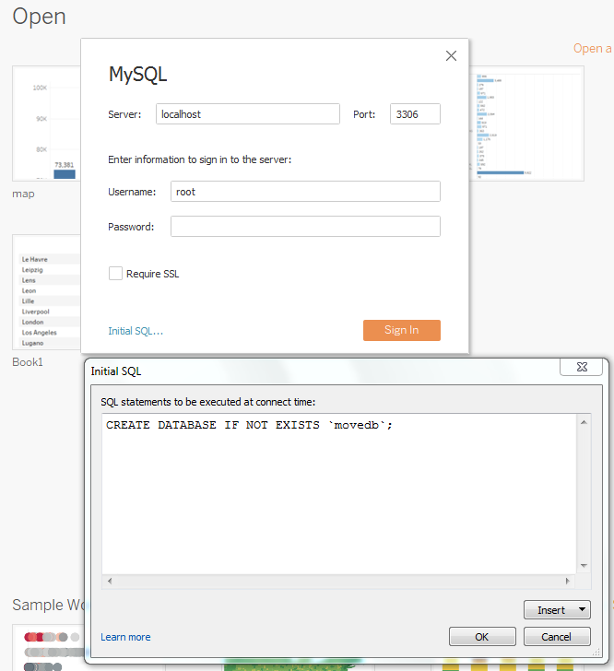
Tableau Connectivity with MYSQL
Open XAMPP Control Panel -Start XAMPP services, open Browser for MYSQL DATABASE.
Open Tableau, Select dbserver
MYSQL
Copy n paste INITIAL SQL string from dump.sql file
Click on Sign in

Slide 4
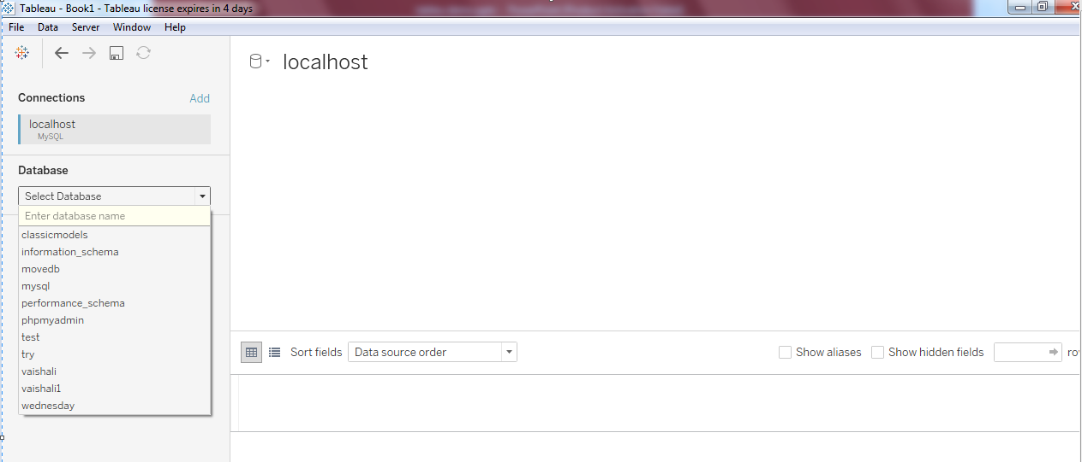
Basic View
Undo symbol
Select database name-

Slide 5
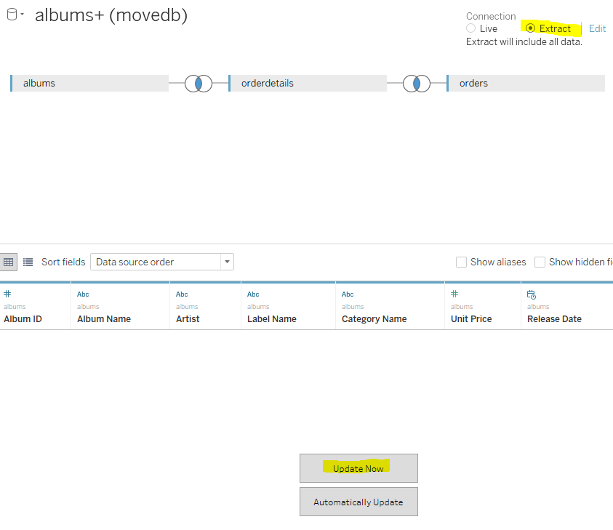
Task- Visualization of the report
Select database name- movedb
Drag n drop tables- album, orderdetails, orders
Click on –extract and update now
Dataset will appear in window pane.
Explore the different buttons in window pane.
click on Go to Worksheet .
Save the worksheet by double click on it.

Slide 6
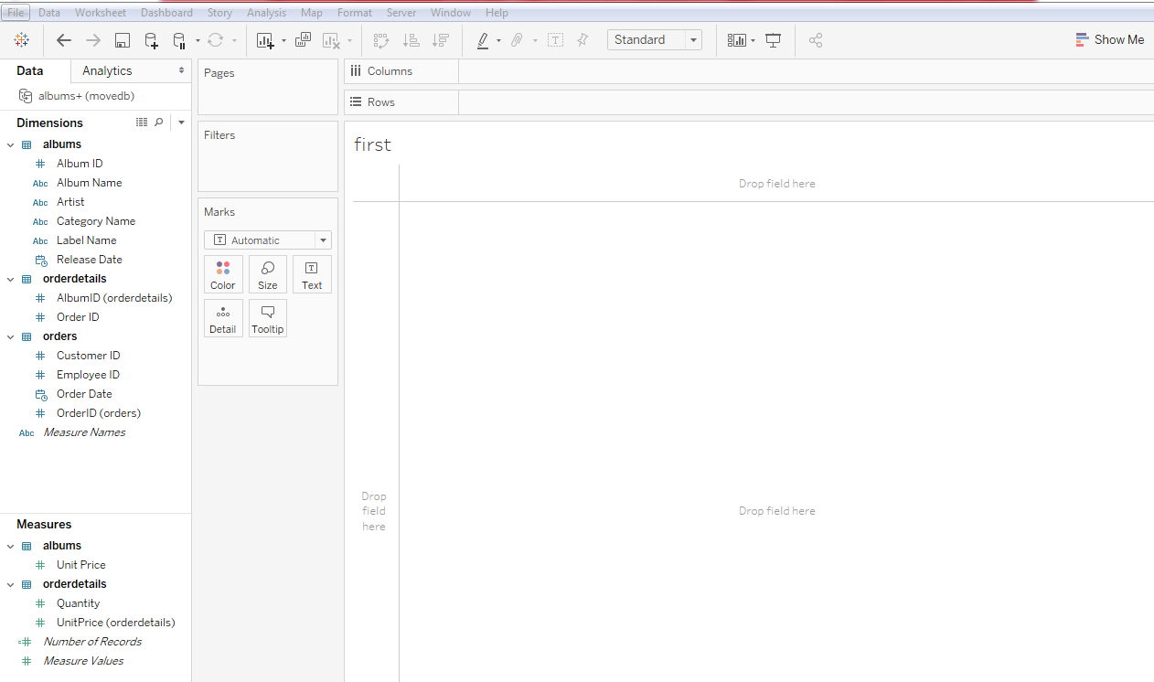
View for selected dimension and measure
Rotation
Sorting
For displaying various types of maps
Dimension /Measure notation ABC= string data type
# = integer
Date data type
3 types of Panes

Slide 7
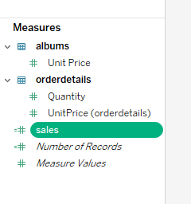
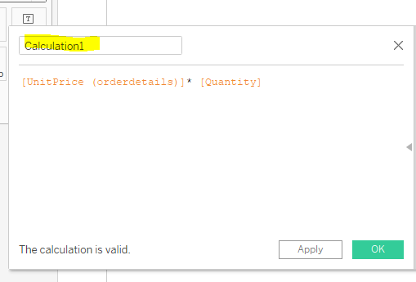
To add user defined measure
To add new measure Sales :
Select menu Analysis from tool bar
Go to Create calculated field
Drag and drop the measures from orderdetails
Change name to Sales

Slide 8
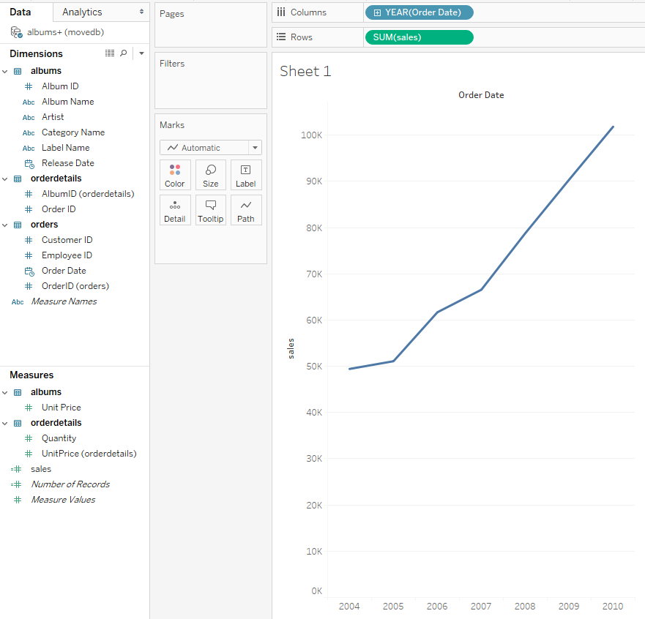

Prob.1- Analysis of yearwise sales [increasing/ decreasing]
1/3
Go to dimension section
Select orderdate(Order) from dimension , Drag and drop it TO column section.
Go to measure section
Select the measure sales Drag and drop it TO rows section.
Default is line graph.
Select symbol from menu bar to display the
values on graph. Also available in marks pane.
Click on to display the
levels(Q,M,W) in date.
The different colors of the fields
Blue indicates Discrete values
Green indicates Continuous values.

Slide 9
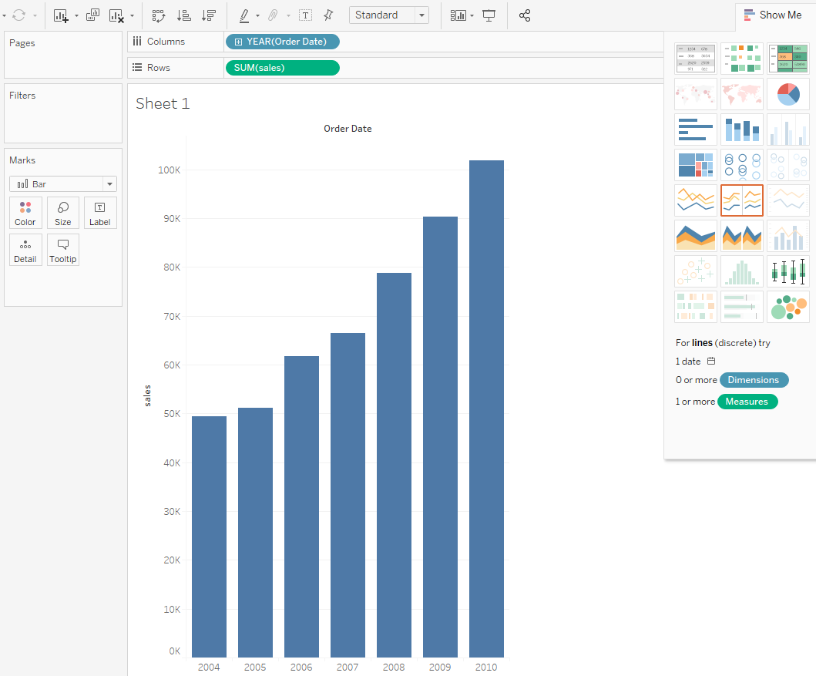
Various functionalities
2/3
Sorting
Swapping
Explore the data using show me
Click on show me
Select horizontal bars graph type.
Click on swap from menu bar.
3 types of Panes, drag

Slide 10
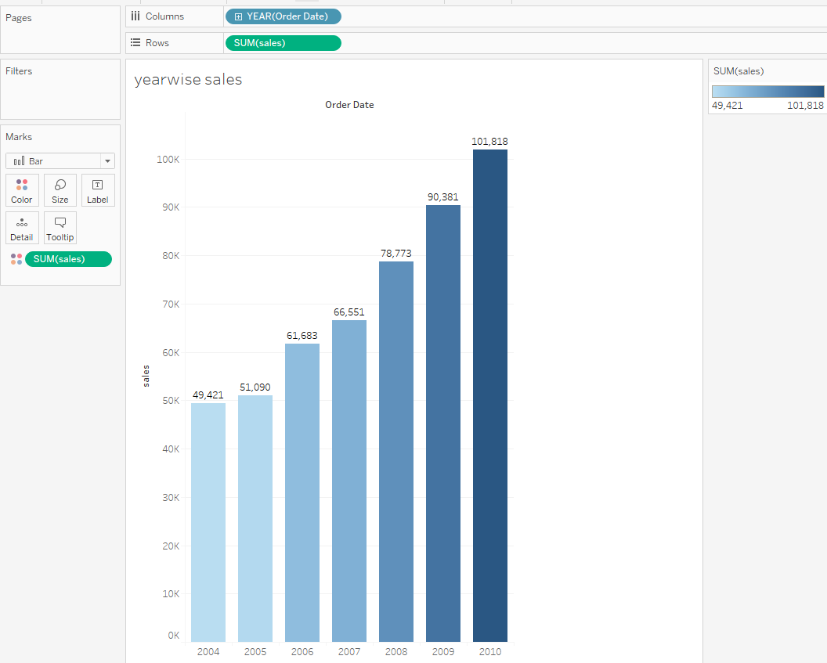
Exploration of filter pane, marks pane, show me menu.
3/3
Drag and drop sales measure into marks pane.

Slide 11
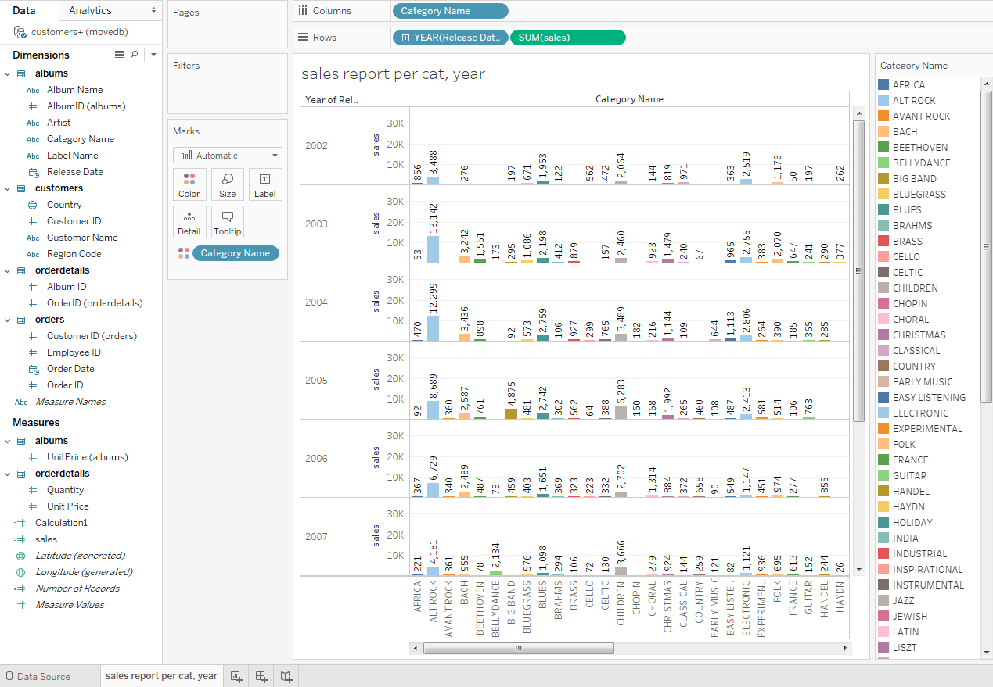
Reflection spot: Question: 1.Display the report per category , by orderdate and sales wise. 2. Display quarter and month wise too.
Click on + sign of year
Hint:
Open new worksheet
Drag dimension category name to columns.
Drag date field and sales measure to rows.

Slide 12
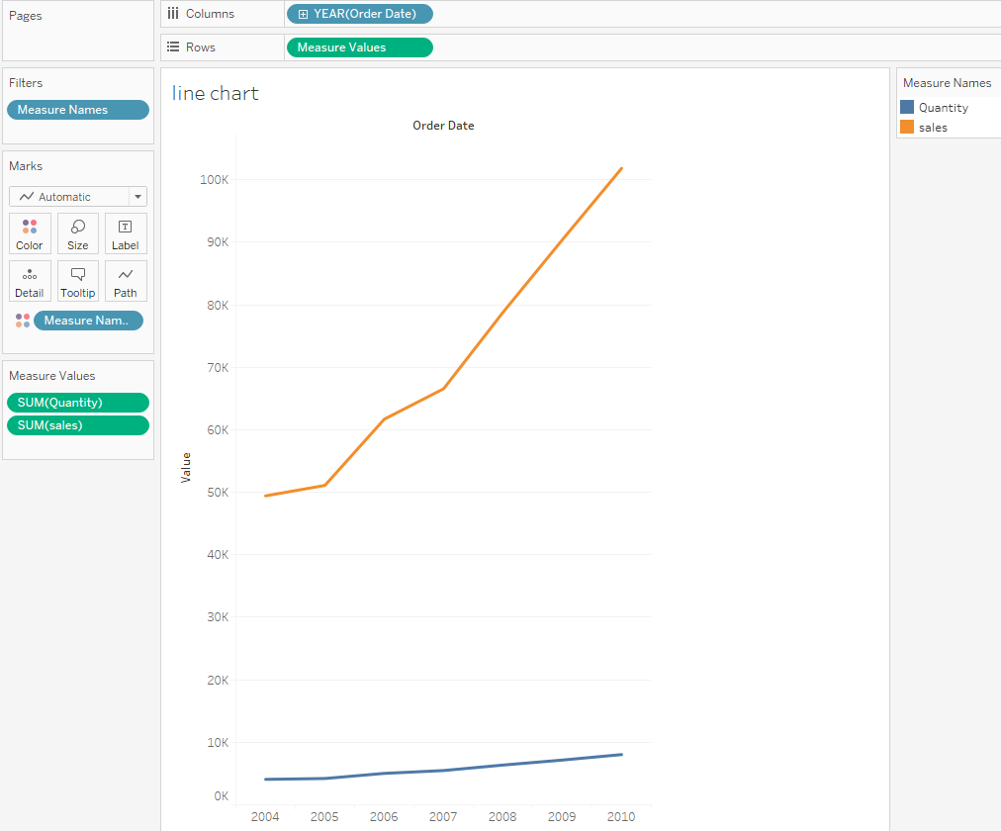

Prob.2: Sales and quantity growth chart
1
From dimension section drag Order Date over the Columns, and from measures section Sales over Rows
From measures section drag quantity measure over the left side of axis.
Click on to see the result Q,M,W.
Label the worksheet as SQG sheet

Slide 13
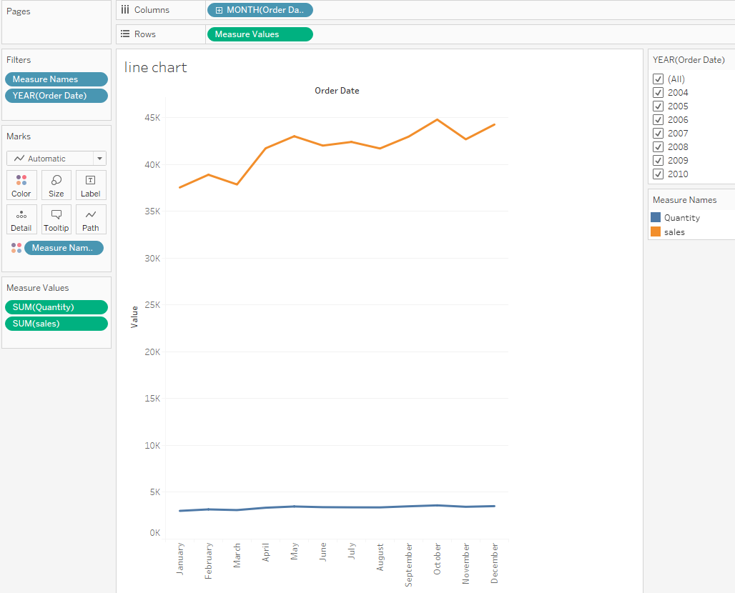
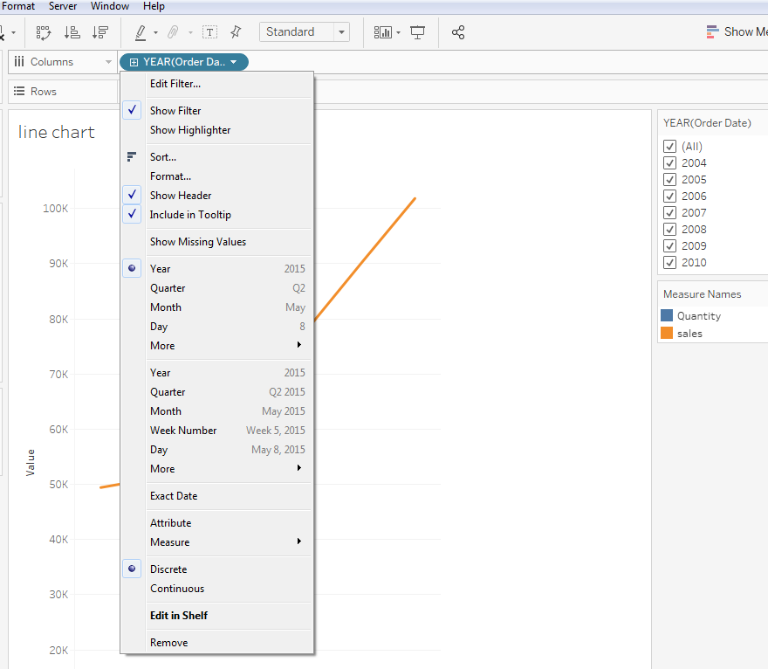
Prob.3: Peak Sales and quantity Monthwise
1
Repeat the same to find the Peak Sales and quantity Months, but change the format of Order Date, from Year to Month.
See the effects of changing the year into column.

Slide 14
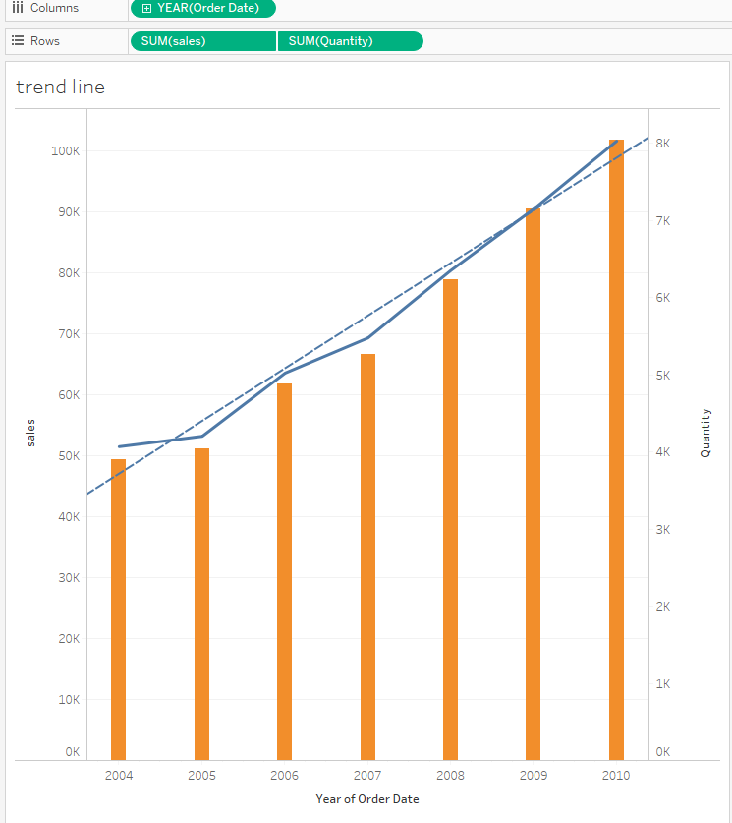
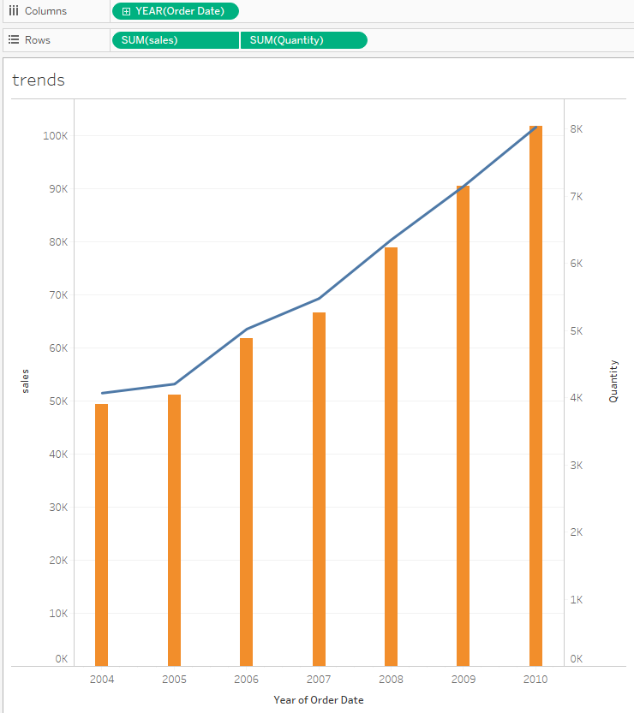
Prob. 4: To understand the pattern of sales and quantity yearwise(Analytics )
A trend line is a straight line that connects two or more price points and Straight or curved line in a trend chart that indicates the general pattern or direction of a time series data (information in sequence over time) then extends into the future to act as a line of support or resistance.
Make a duplicate copy of the yearly sales/quantity growth sheet (SQG)rename to trend line. Go to Show Me and choose the Dual Combination chart, to get this chart :
To get the Trend Line, go to Analytics tab, and simply drag Trend Line over the chart.
Scroll the mouse on line to determine/ understand the values

Slide 15
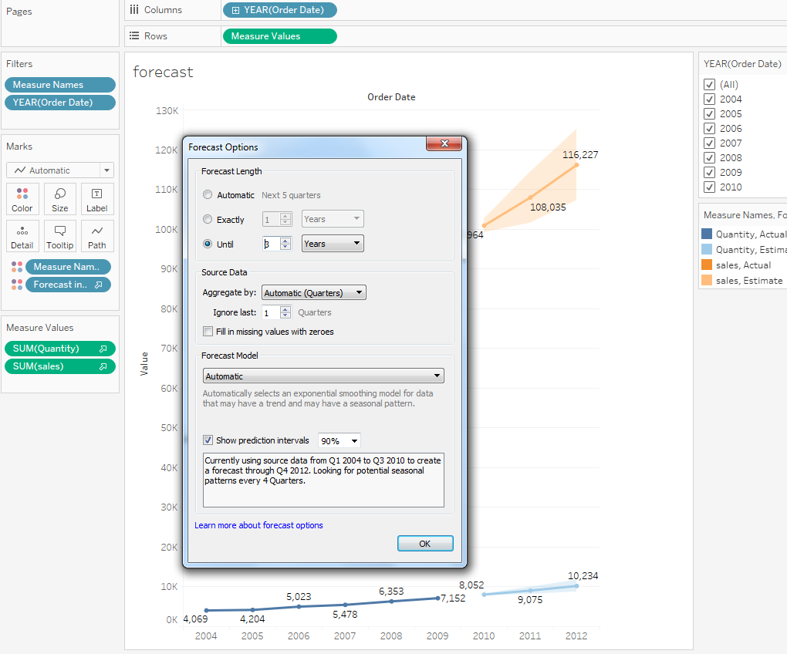
Forecasting
Prob. 5 : Sales and quantity Growth chart (Analytics- forecast)
Make a Duplicate of the SQG Sheet rename to forecast:
Drag Forecast over the chart.
You can also change the time frame of the Forecast, by right clicking on the Forecast Area and opting for Forecast Options, after which you can make your customizations :
Click on label from the mark pane to display the proper values.
Use more filter option for any field. Right click on orderdate field go to show filter - uncheck the year .
Understand the difference in forecasted values over the line.

Slide 16
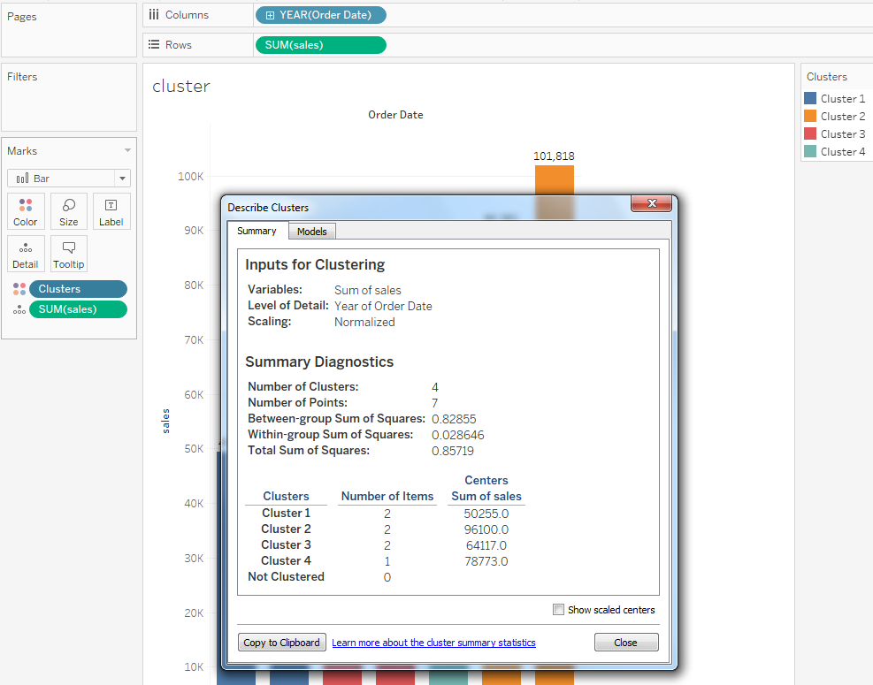
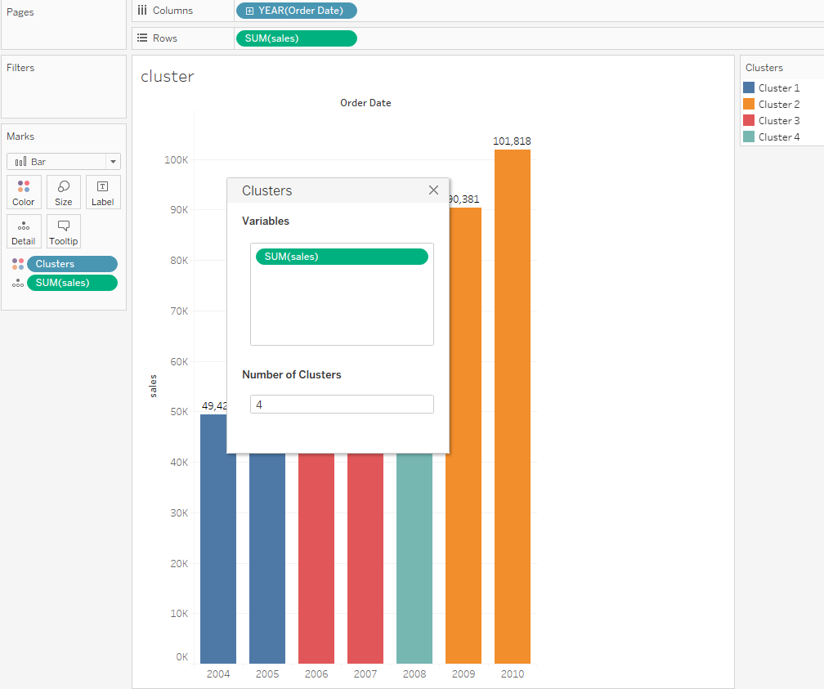
Analytics - Clustering
Make duplicate sheet of year-wise Analysis chart for Clusters rename to cluster.
Go to Analytics tab and choose Clusters.
You can format the Cluster formation as per your wishes. Here we are clustering based on the Sum of Sales choosing the number of clusters to be 4
To view the Cluster information, right click on Clusters in the Marks Pane, and select Describe Clusters, to get this pop up : understand both summary and model tab.

Slide 17
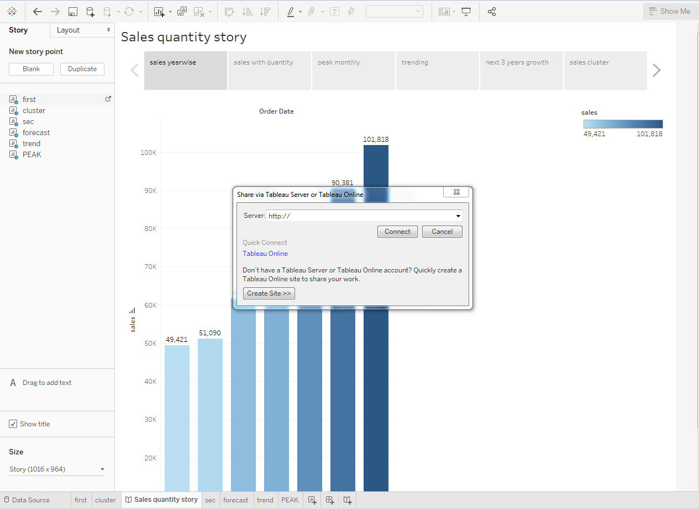
Sharing the sales-quantity Story
Presentation mode
Share with others
Story is where you combine all the dashboards, or worksheets and if need be individual Sheets as well, to convey.
Select the story from menu bar .
Click on new story .
Add a Caption to all of your Dashboards/worksheets to convey your message clearly .
To add new story point
click on blank drag the worksheet/ dashboard.
At end it may look like this.
Click to view the story/dashboard in presentation mode or share with other if u have tableau server.

Slide 18
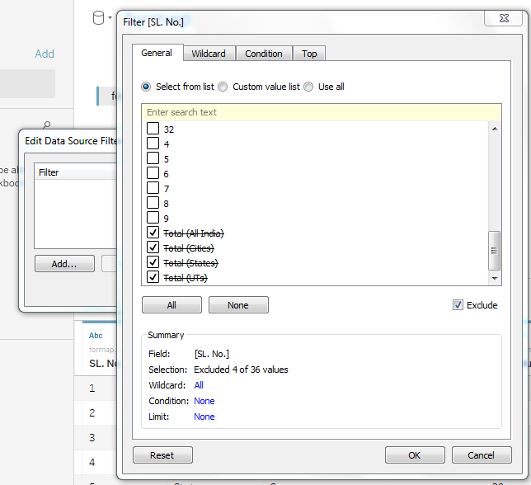
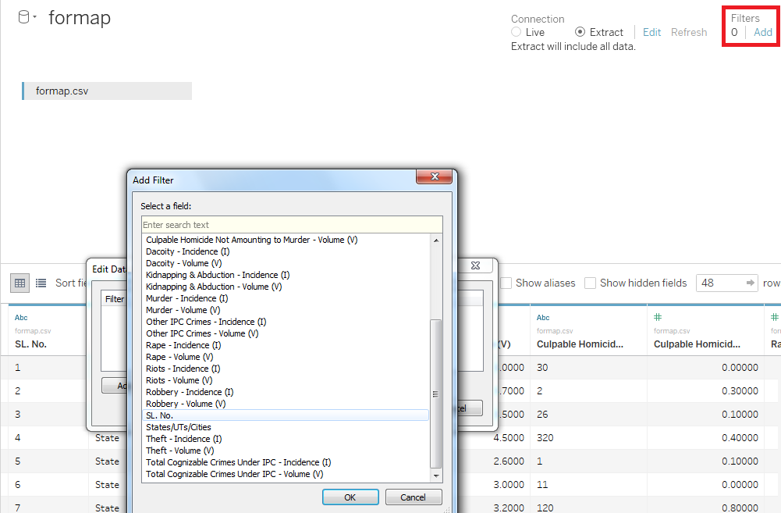
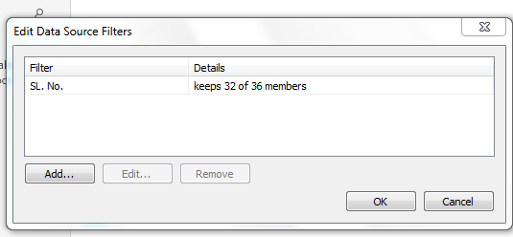
Connectivity with files- Text Files(.CSV)
Open Tableau, Select .csv file
Change to extract.
Observe the data – filtering needed

Slide 19
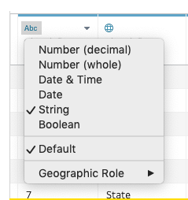
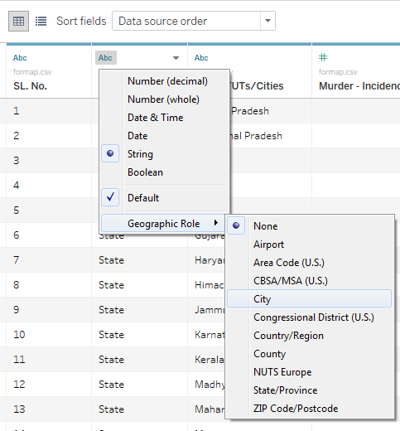
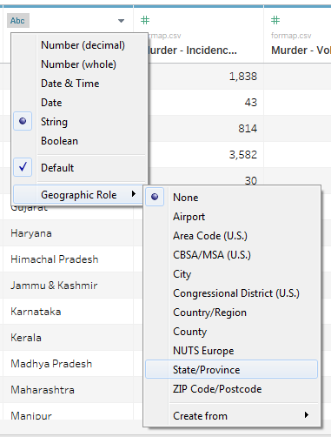
Changing data type from window pane
Change the data type of field category, state/UT i.e. string to geographical location.
It lets to identify geographical locations which will help in plotting maps.
To change the data type, click on the current data type (such as Abc) , select a new type from the drop-down. – Geographic Role

Slide 20
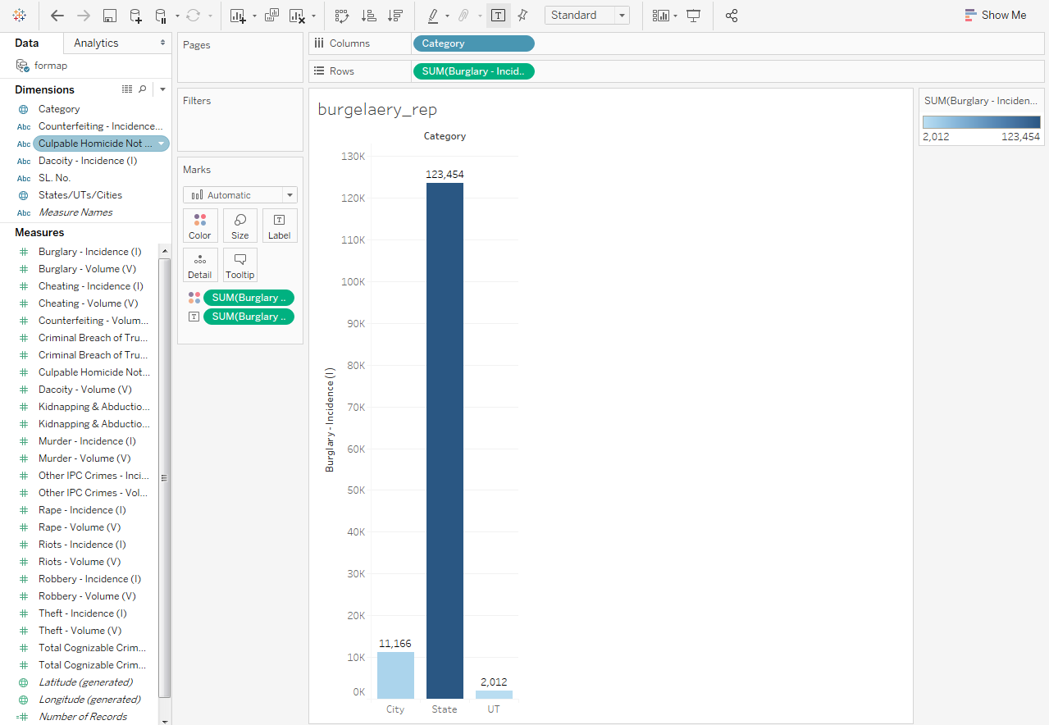
Prob.1: Display State/UT/City Wise Burglary Incidents In India
Bar Chart
Drag and drop the Category feature from the Dimensions tab to the Columns area.
Drag and drop the Burglary Incidence feature from the Measures tab to the Rows area.
To add colour to the graphs, drag the feature Category (or Burglary Incidence) to the Color button in the Marks Tab.
Add label to the bars by dragging the feature Burglary Incidence into the Label button in the Marks Tab.
Rename the worksheet as burgelary report

Slide 21
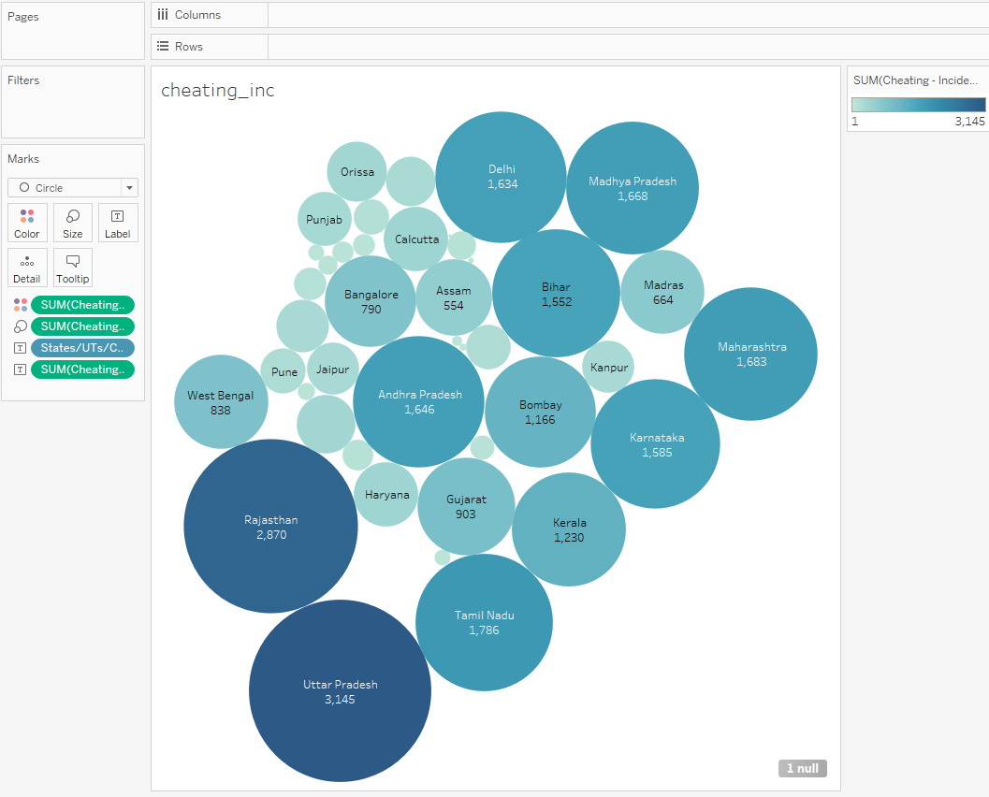
Prob.2: Report of Most cheating Incidents In India State/UT/City Wise
Bubbles Chart
Click on new worksheet rename to cheating_inc.
Drag and drop the States/UTs/Cities feature from the Dimensions tab to the Columns area.
Drag and drop the cheating Incidence feature from the Measures tab to the Rows area.
Select the Packed Bubbles graph from the Show Me Tab
To add colour to the graphs based on intensity, drag the feature cheating Incidence to the Color button in the Marks Tab.
Add label for the count of cheats in each state by dragging the feature cheat Incidence into the Label button in the Marks Tab

Slide 22
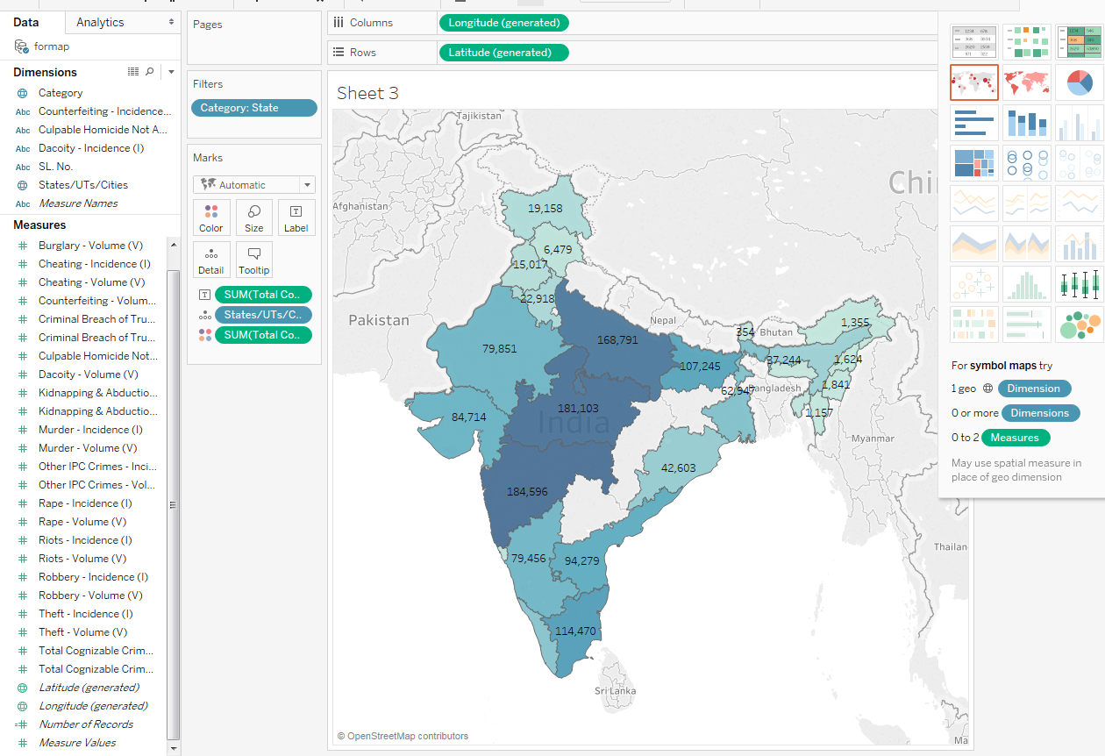
Prob.3: Display Most Cognizable Crimes Under IPC State-Wise
Choropleth Plotting
Click on new worksheet rename to crimes _inc
Drag and drop the States/UTs/Cities feature from the Dimensions tab to the Columns area.
Drag and drop the Total Cognizable Crimes Under IPC – Incidence (I) feature from the Measures tab to the Color button in the Marks Tab.
Add a filter in the visualization worksheet by simply dropping the Category feature into the Filter Tab. Set the filter as states..
Select symbol maps from the Show Me
Add label for the state wise count of Total Cognizable Crimes Under IPC by dragging the feature Total Cognizable Crimes Under IPC – Incidence (I) into the Label button in the Marks Tab

Slide 23
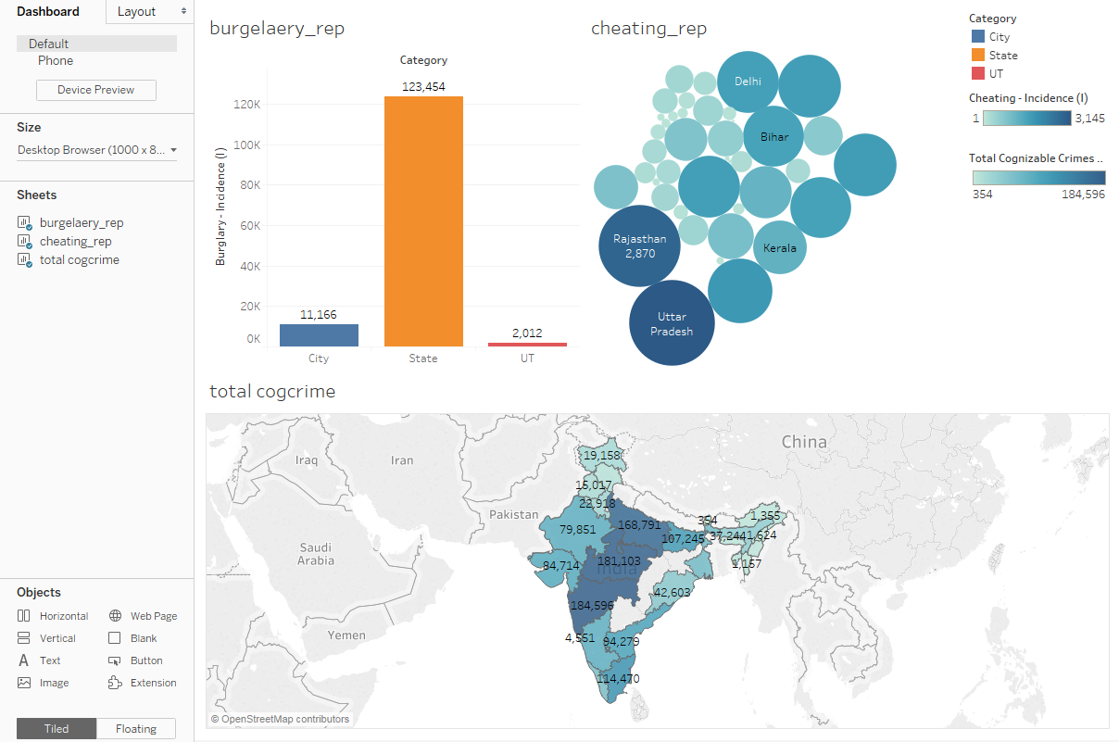
Dashboard
Dashboard is simply a means of combining Worksheets together so that they convey some message.
Click on the window like icon next to the ‘New Worksheet’ icon in the bottom pane to get the following/menu- new dashboard
See the multiple Worksheets that we had made is to drag these sheets from the pane to the empty area ‘Drop sheets here’.
Arrange the worksheets horizontal/ vertical/ shown in the image.
The changes done in individual worksheets are reflected in dashboard too.

Slide 24
Making dashboard Interactive
Click on any one bubble of state from cheating_rep , other worksheets data gets changed to match with the selected filter..
Select the cheating_rep worksheet from dashboard
Go to symbol then select use as filter

Slide 25
Thank you

